Slide 1
Facilities Accounting Advanced
Cherie Chenoweth, Coordinator Facilities Business & Compliance
San Juan USD – Facilities Department
Email: Cchenoweth@sanjuan.edu
Phone: 916-979-8629
Lettie Boggs, CEO
Email: leboggs@ColbiTech.com
Phone: 714-412-2216
Notes:
Slide Notes by Lettie Boggs

Slide 2
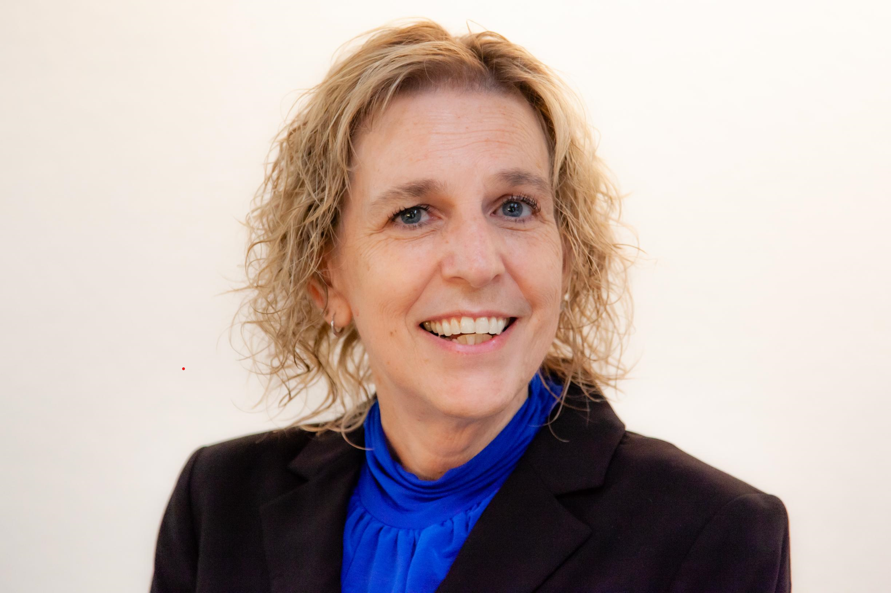
Cherie Chenoweth
Coordinator Facilities Business Compliance
San Juan USD – Facilities Department
916-979-8629 Cchenoweth@sanjuan.edu
Cherie has been with San Juan Unified School District for over 19 years, serving various roles throughout my tenure. Currently she is the Coordinator of Facilities Business & Compliance, overseeing fiscal and procurement for transportation, construction, M&O and custodial. During her time at the district, she has been responsible for multi-delivery procurement methods, developed and created cash flows for bond tracking and sales for three bonds equating to $1.2 billion. She has also been at the forefront of the district’s digital transformation to a construction system, that manages the entire program from start to finish with everything at your fingertips.
When she is not working, you can find her on a cruise ship.

Slide 3
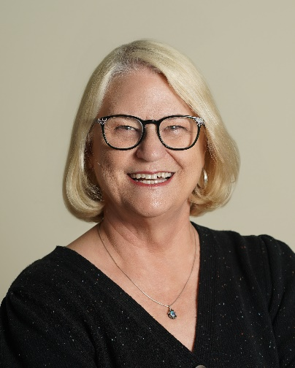
Lettie Boggs, CEO
714/412-2216 leboggs@ColbiTech.com
Lettie Boggs held both Director of Facilities and Assistant Superintendent positions before starting COLBI in 2002 where she currently serves as CEO. She was also Vice President for Business & Finance at Vanguard University.
Lettie is the President Elect for the SoCal Chapter of A4LE. She has served on the board of the Coalition for Adequate School Housing and was one of the founding faculty of the CASH School Facilities Leadership Academy. She also served as Chair of the CASBO School Facilities Professional Council. She served as Chair of Californians for School Facilities (now CFN) and continues to participate as Board Member Emeritus.

Slide 4
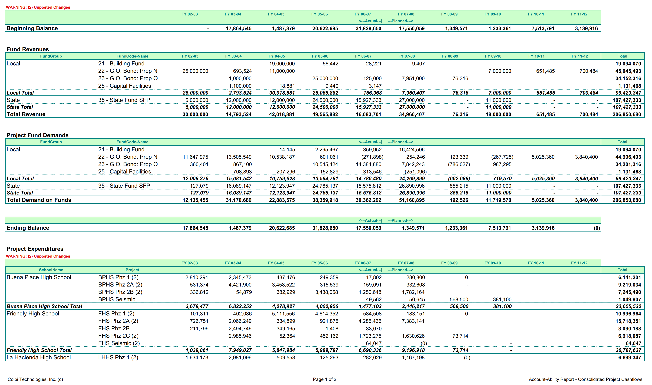
Budgeting
The budget is a picture of your project drawn in numbers
Notes:
Project budgeting should start about the time you have an idea that a project is needed. At first it is a bit like a sketch, just a rough outline of what it will be. Then as more is known, the budget becomes more like a drawing. By time it is fully designed and ready to bid, it just needs refinement. As you build the project the expenditures are monitored against that budget. And at the end of the project, that record is a picture of the project drawn in numbers. It is a full and complete representation of what was accomplished.

Slide 5
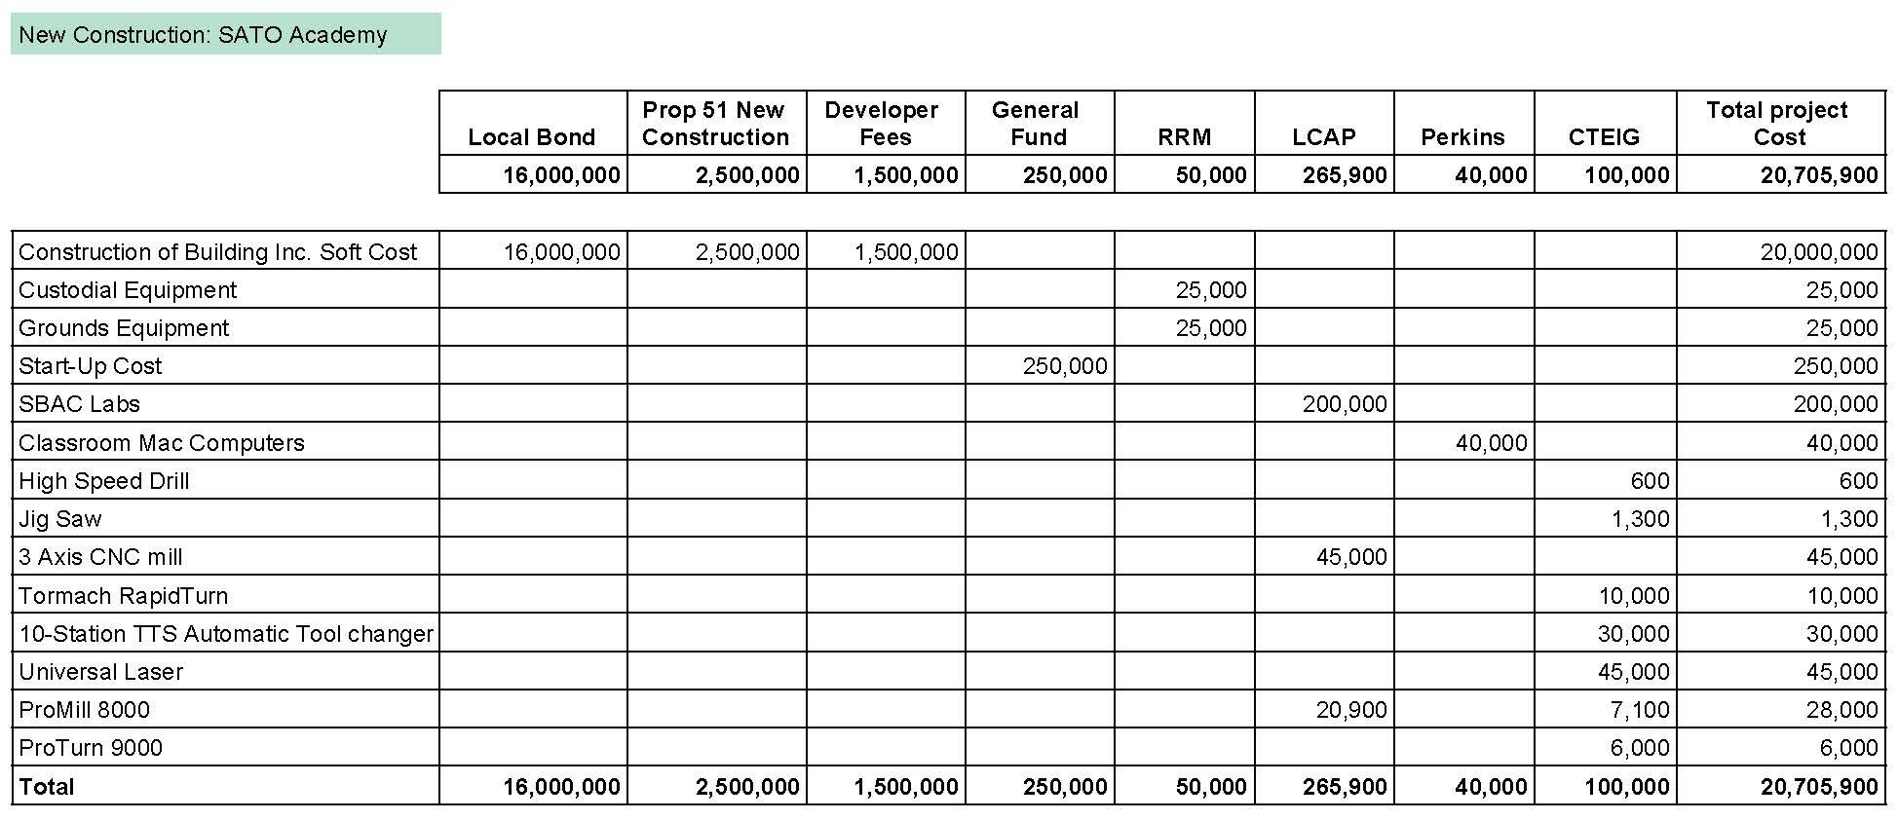
Multi-Year + Multi-Fund
Multiple sources with varying availability over several years
How fun is that ?!?!
Notes:
Budgeting school facilities projects requires multiple funding sources over multiple years. This is particularly challenging because the accounting system for K-12 public schools is mandated to be an annualized single fund system. Schools work to never co-mingle funds and expenditures, and then in the Facilities Department they are busy using multiple sources for projects! In this area, as in so many others, Facilities is the exception to the rule. This is primarily because the Facilities Department is in the development business within a system designed to be in the education business.
It is important that the district has the ability to clearly communicate the funding plan envisioned for each project. The more complex it is, the more possibility of funding availability challenges. It is critical to track each funding source with knowledge of the requirements for nexus to that funding. State funds (F35) have very specific eligibility requirements, Developer Fees (F25) and CFD funds have to have a nexus to impacts from growth. Bond funds (F21) must comply with the authorizing bond language. And grant funds must follow the grant requirements.
A plan should be worked out with Fiscal to link each project with its funding requirements and justify how the projects satisfies the them. Coding of Purchase Orders and Expenditures should also be coordinated so that program requirements are met for each funding source. Things that might be supply items in the general fund might qualify as capital expenditures when associated with a capital project. These nuances need to be understood by both departments and protocol agreed upon so that there is not a significant amount of transferring that then complicates various program audits.

Slide 6
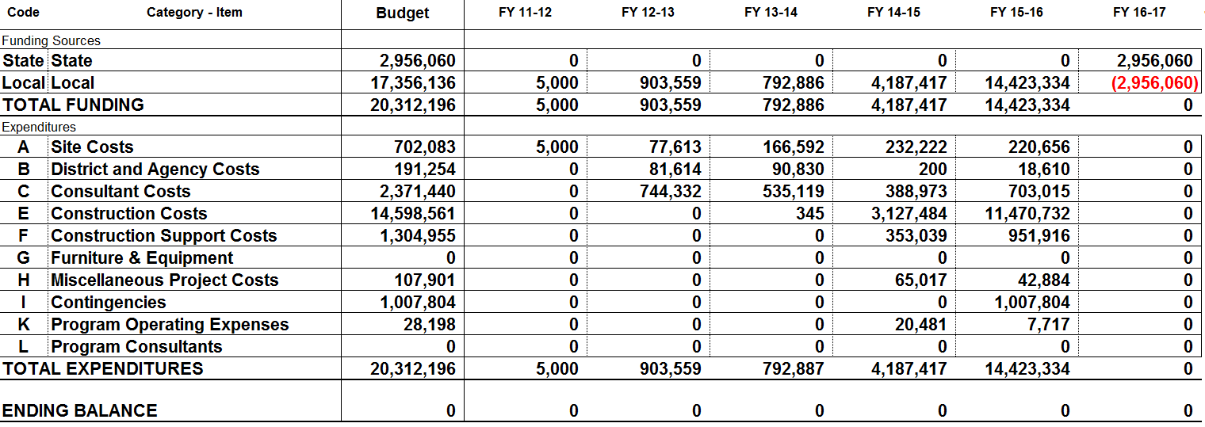
In the Spring review each project budget – reality check
On track to finish on budget?
Reconcile expenditures with fiscal
Project end of year status
In the Fall review each project budget – reality check again
On track to finish on budget?
Reconcile expenditures with fiscal
Document project end of prior year status
Notes:
Every project needs a budget showing the funding sources and the projected expenditures by object code. But that is not the whole picture. The next step is to age that budget over the life of the project. It is usually easier to build the expenditures first, then make sure the funding is covered annually from funds contributing to the project and available in each fiscal year.
Then as the project is worked it is important to verify that it stays real. Design and construction are complex processes and the funding requirements can change for a project as more is known. Two story rather than one, wet or clay soil, and other such factors, once known, should result in modifications to the budget to assure that the district is maintaining adequate funds for the project.
In addition to major impacts that should result in budget adjustment as soon as they are known, every budget should be reviewed periodically to verify that it reflects reality for that project. We recommend at least twice a year. Once in preparation for fiscal closing and again after closing to adjust the prior year to actual expenditure numbers. Then the remaining budget can be spread to the remaining project years.

Slide 7
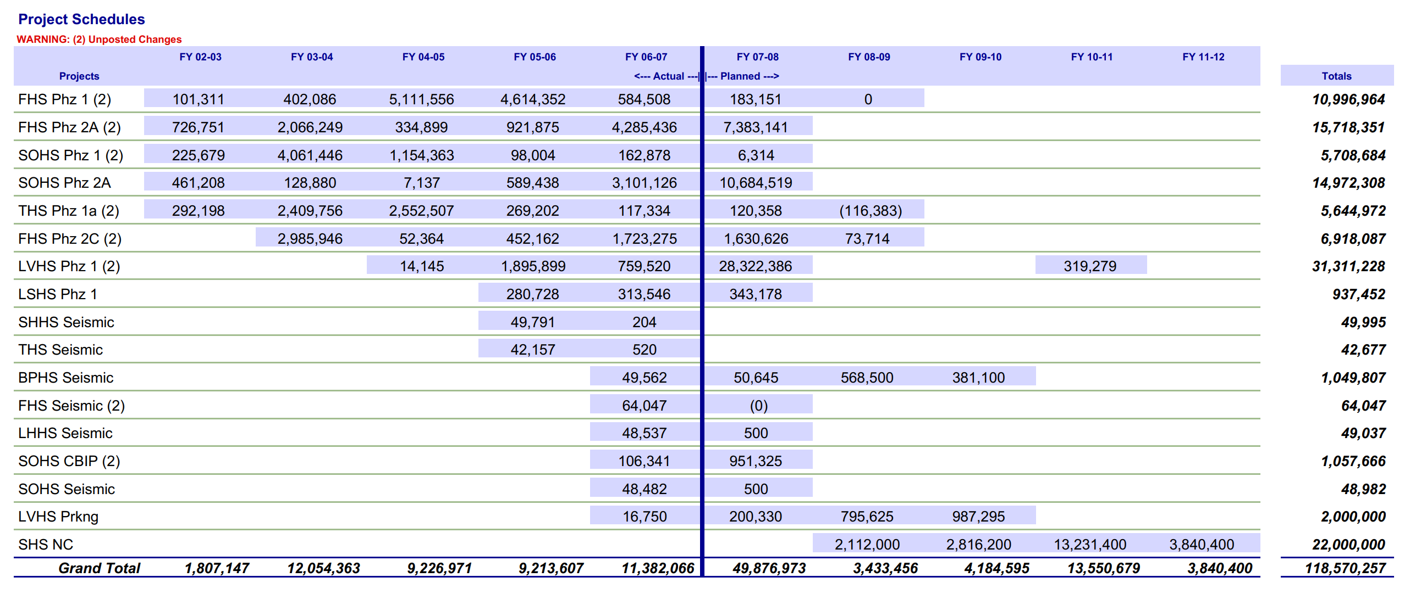
Timing!
If you are running through the money faster than budgeted – it does not mean you are getting done early!
Establish good controls…
Budgets should be monitored to reflect reality
And then expenditures should be monitored to be within budget parameters
If you are not spending as fast as anticipated – it probably means that the job is behind schedule and usually means more cost overall
Notes:
By verifying the pace of spending against the budget, you can see if the pace of spending is going as anticipated. If not, note whether money is going out faster or slower, it may mean that there are factors on the job that could end up making the job cost more than originally anticipated. The budget may need to be augmented or the delivery of the job adjusted. The earlier the district is aware of pacing issues the easier it is to react appropriately.
It is important to establish budgets and then monitor expenditures against them so that the district has this significant warning system. The district system does this by fund, but with Facilities projects using multiple funding sources, it is important to pull that picture together and track it on a regular basis.

Slide 8
There is Funding available by source – for the whole program
And then there is the demand placed on that funding
Notes:
When each project has a budget, then those budgets, added together, create the program budget, conveying the entire program by project, and by year. The fund demand of those projects can then be monitored against the cash flow for the funds.
A large program should have a budget for unallocated funds held for inflation over the life of the program. This budget also manages funds available for contingencies and changes to projects. Retaining funds to adjust for the unknown allows the district to deliver on promises made without having to raid other project budgets – a very unpopular and undesirable practice!

Slide 9
Contracts & Expenditures
Track what needs to be known – and nothing more
Notes:
School district accounting is designed to take good care of the taxpayers money. The system operates on established budgets. Purchase Orders and Contracts are made within the budget parameters, and payments are then made within the PO/Contract parameters. This assures that the board approved budgets are honored.
Within this system there are several control elements. One is the PO/Contract system. Every PO is numbered and the Purchasing or Procurement department is charged with maintaining the numerical control. Voids are monitored and unauthorized expenditures prohibited. A second control is the warrant or check system. Every warrant is issued within a controlled payment protocol. Fiscal is charged with monitoring this control.
When a district accepts state funding, they accept a third control requirement – project level control. This requires that a unique identifier is applied within the district coding structure and the expenses are monitored and reported at the project level, inclusive of multiple funding sources.

Slide 10
Internal Controls
Do you foster getting forgiveness rather than permission?
Do you consider how graft might be occurring? Who is at risk of accusation?
Do policies exist that protect the district and employees?
Are they known? Followed?
Are processes appropriately transparent?
Who checks? Who knows?
Control Environment
Risk Assessment
Control Activities
Information and Communication
Monitoring
Notes:
COSO has established five areas critical to maintaining a good internal control environment. PO and Payment systems fall within Control Activities and Monitoring. Each of the control areas should be considered and the district should take care to maintain the right environment in each area.
School building programs involve the expenditure of significant amounts of money, often at a greater pace than the entire general fund of the district. This can present a moral challenge to school district employees and board members. And this is an area where real people are convicted of crimes and do jail time. It is important to build in good controls and monitor them throughout the course of the program.

Slide 11
Flow Charts
Clarify roles and accountability
Trail of internal control
Reveals appropriate redundancies
—and inappropriate as well !
Notes:
One way to establish good controls is to flow chart your internal systems, such as the PO/Contract process, payment process, change orders, stop notices, etc. Then establish monitoring so that the district will have awareness if the processes are not being followed.
The flow charts, in addition to allowing administration to verify they have appropriate redundancies, also allow them to see where their processes are inefficient and could be improved. They are also a great tool for onboarding new personnel, helping them see where their role fits in the greater effort.
One of the challenges when staffing is reduced, either by illness, vacation, or budget cuts, is that the work is often given to the person who is the second set of eyes. This has the effect of breaking the control. Administrators should pay specific attention to the controls systems during personnel changes, even temporary ones.

Slide 12
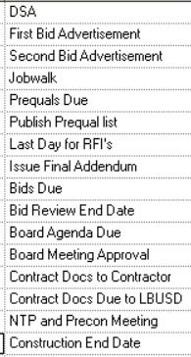
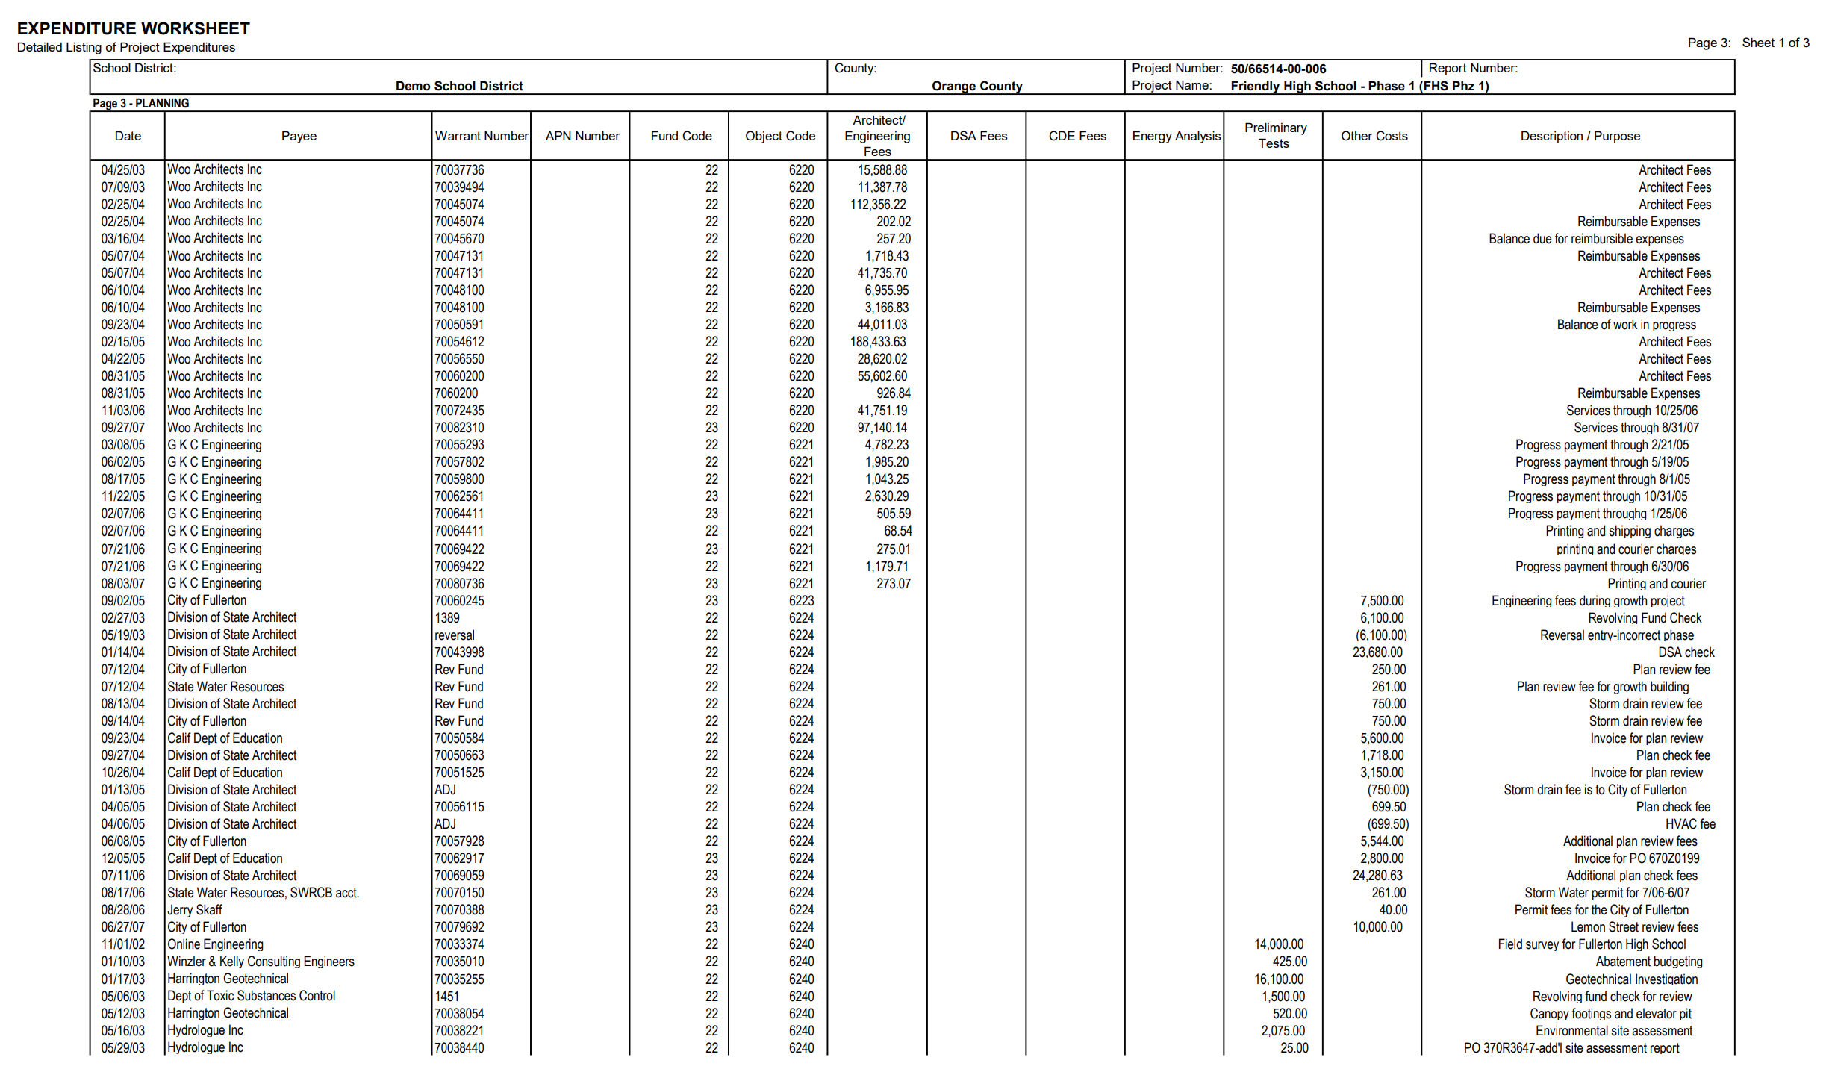
MONITOR EXPENDITURES
Pay attention to splitting costs
Who is making the decision?
The clerk, the director, or the CBO
Make sure the delivery method and the contracting meet Public Contract Code and Office of Public School Construction criteria
Track the rule changes
Resist overcomplicating the tracking
Spend effort tracking what you really need to know
Notes:
Accountants are very good at tracking things, but someone needs to make sure that the district isn’t spending great amounts of effort tracking things at a level beyond the detail needed. Does the level of effort needed to track the information match the value of the information? Some things are nice to know, but the information needed can be achieved through an analysis of a sampling of contracts or invoices, for instance.
The levels of coding given in the handout for the Basics course is a generally accepted level of detail to provide good project numbers and meet reporting requirements of school boards and oversight committees.
One of the most challenging areas where complexity needs to be addressed is in the area of splitting costs, either between sites for capital value, or between projects when two projects are bid together. For example, in the case of establishing capital value some districts choose to split the coding on every PO/Payment. This does track it at every level, but it increases the time and effort to do every PO/Payment by the number of sites involved. If you have 3 sites, it is 3 times the work. Eight sites would be 8 times the work.
If that same project were managed as one project and then allocated to the multiple sites quarterly, for instance, it would require significantly less labor and the allocation would now be at the director or CBO level.

Slide 13
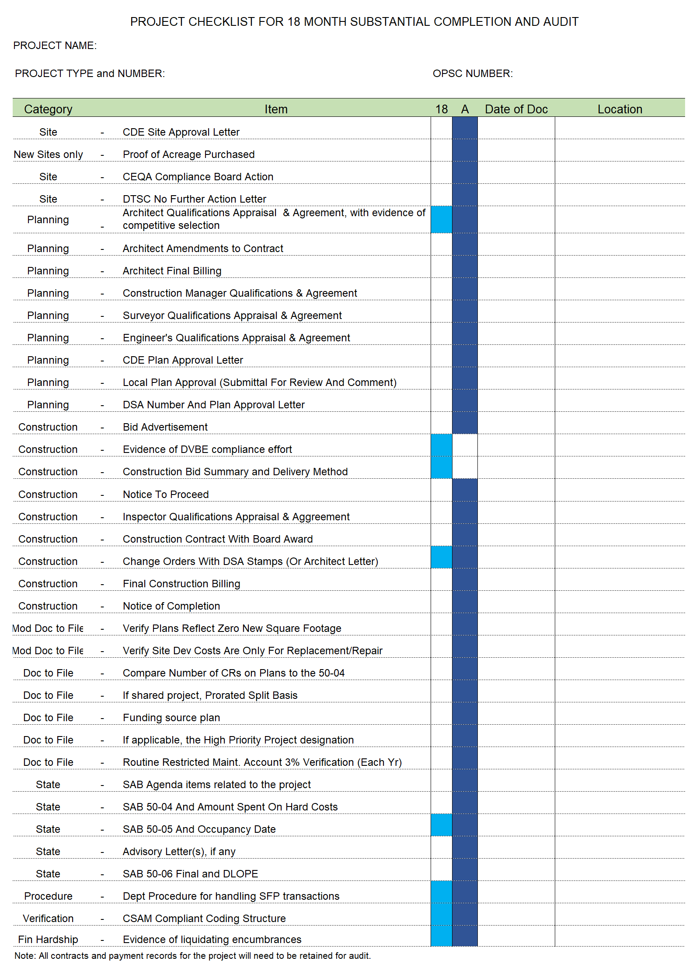
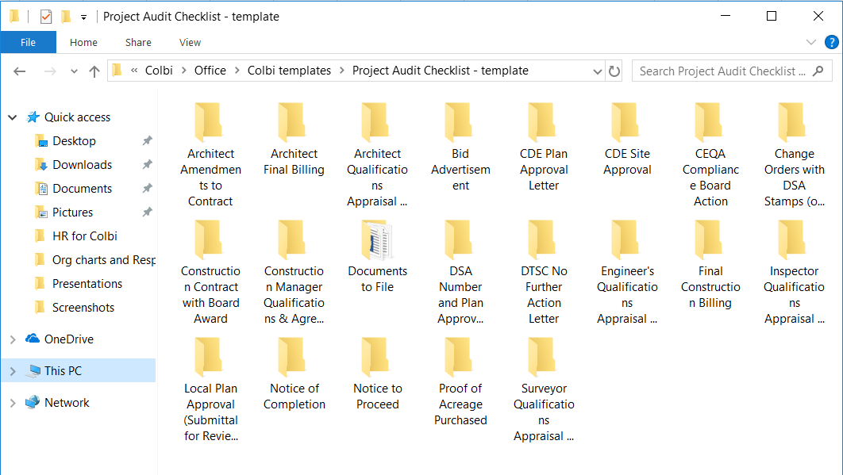
MAINTAIN THE
PROJECT RECORD
Use the Category/Object lists from the basics course to tag your items for storage & retrieval
Plan for audit by saving components as you go
Begin with the end in mind!
Notes:
The California Office of Public School Construction’s School Facilities Program has very specific audit requirements that require some extraordinary tracking. The list in this slide was developed by going through the Audit Guide and listing every item that the auditors were required to verify. The list was made so that participants in the program could save them to the project record in a way that will facilitate a clean audit at the end of the project. Whether the district just saves them in windows or tags them in their storage system, the result needs to be that they are readily available at the end of the project. This is easier if you collect them as the project occurs. Remember, if you fail audit items in the SF{ - you give the money back!

Slide 14
Systems & Processes
Create progressive movement
Provide protection for district and employees
They are chaos killers
A river without banks is just a big puddle.
Will Mancini
Notes:
Good systems not only improve internal controls, they create movement. Consider the statement, “A river without banks is just a big puddle.” When you take that same environment and put banks on it, the constraint creates flow or movement. In a process, when you create a next step and hold someone accountable for moving the item off their desk to the next step, you create flow.
If it is up to a person, with no assistance from a process, to create movement – it is exhausting! And it falls apart when the person is ill or on vacation. It is a significant risk for the district. It is the leader’s job to create systems and movement. And it makes things happen in an orderly and predictable pattern, which allows people to work together to achieve common objectives.

Slide 15
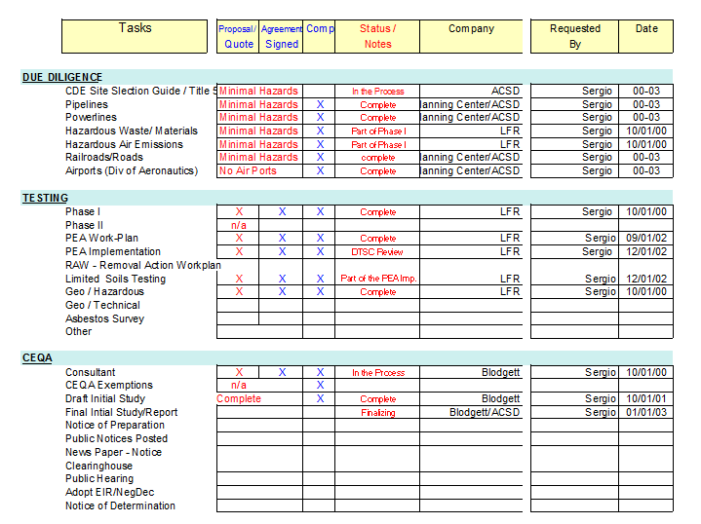
PROCESS TOOLS Timelines and Schedules
Calendar
Schedule
Action Plan
Responsibility Matrix
Timeline
Notes:
There are tools that can be used to create the banks. An accountability matrix, action plans, meeting minutes, and schedules are typical tools that are used to create flow and accountability in facility projects. Just make sure that they have purpose and are not developed without being used or monitored. Make meetings meaningful, organized, and productive – or don’t have them.

Slide 16
Reconciliation
Singular processes don’t require reconciliation
– nor do they provide verification
Notes:
Because the district accounting system is not designed to monitor multi-fund, multi-year projects it is important to maintain a process of reconciliation between the spreadsheets or subsidiary ledgers used by those managing the project and the accounting system.
Whenever there are significant dollars and a program attractive to graft or other inappropriate activities, it is important to be able to verify the numbers of the program two ways. The reconciliation of the two numbers verifies that the district is operating with eyes wide open regarding real costs, and it also reveals areas where there needs to be process improvement.

Slide 17
Reconciliation & Subsidiary Systems
All reporting should match
Automate reporting as much as possible
If reconciliation is a pain – do it more often, not less
If you had a major error, would you know?
We spend most of the time with boots on the ground, get some elevation and look at the big picture too
Excel spreadsheets are a subsidiary system too!
Big important numbers should be verified systemically
Notes:
Be aware that even the spreadsheets people develop to help them with the parts of project or program management that are not well managed by the district accounting system need to be reconciled to assure that both Facilities and Fiscal are on the same page.
It is a natural tendency to not do reconciliation very often as it is not in anyone’s primary job duties and therefore always feels like extra work. And it is a high-level accounting function so it can be difficult. But if it is problematic in your district, the answer to making it simpler is to do it more often, not less! The more recent the expenditures are, the easier to get explanations and to fix errors so they don’t proliferate longer and require more extensive corrections.
And it is important to review the reasons for the reconciliation discrepancies, because they are areas that indicate you have a process issue and need to make process changes. Tighten up.

Slide 18
Reporting
Clarity
vs.
Complexity
Notes:
One of the great byproducts of designing a great system for tracking projects is that it lends itself to good reporting. Complex systems that track mounds of information make meetings difficult and create as many questions as they answer.
One approach to bringing clarity is to summarize information and then be prepared to drill down. Drilling down on a specific project gives confidence to the board or committee that the summarized numbers are real and the team has the level of detail they need to manage projects. Summarized data also allows the board or committee to move up to a level where they can see the whole program and monitor the effect of changes to projects.
It is important for administration to give permission for staff at all levels to fight for clarity and not be willing to live with a cloudy picture that doesn’t tell them what they need to know in order to manage effectively.

Slide 19
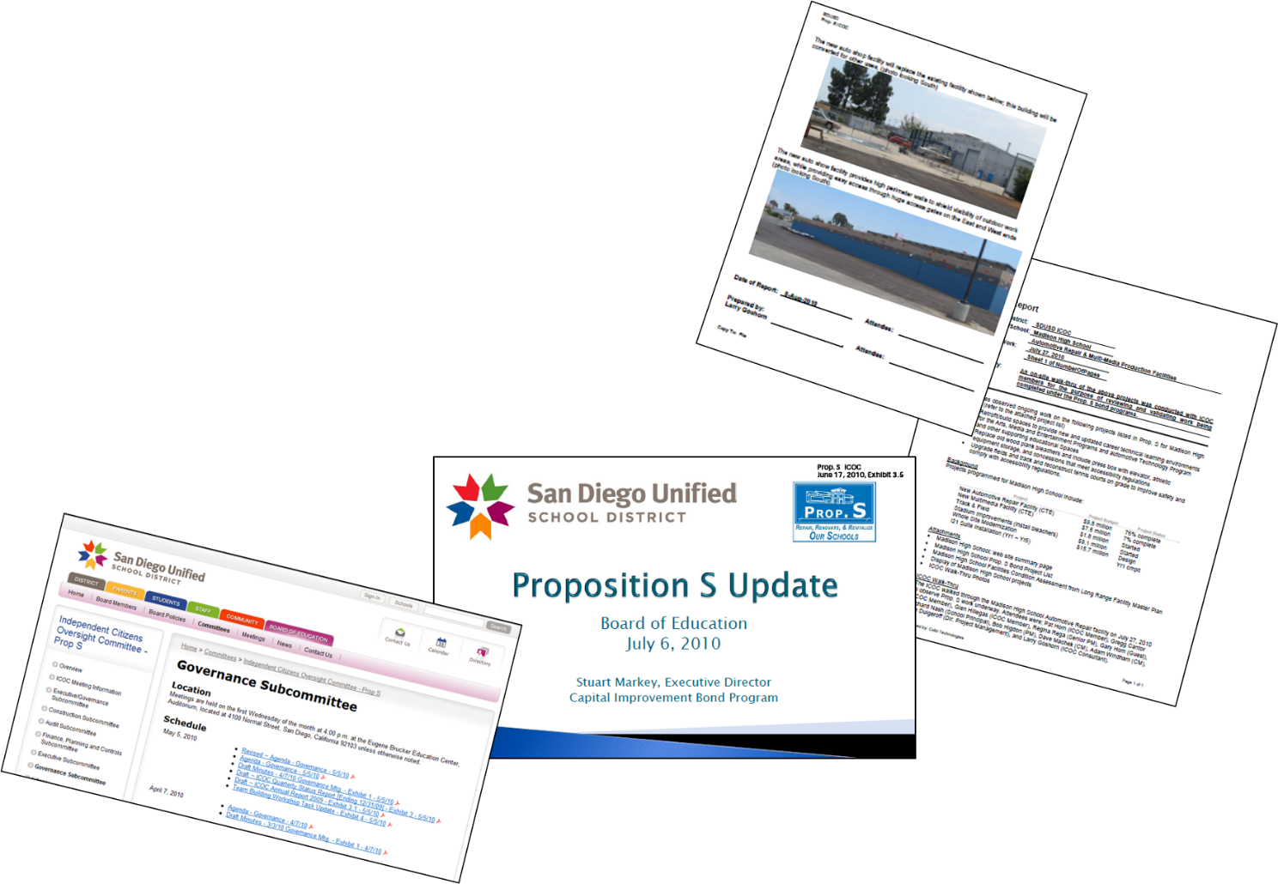
Reporting
Too much information does not bring clarity
Structure the information logically
Lead them through info that will build understanding
What are the right questions?
Layering is effective
Summary on the PPT
Mid level detail in the handout
Full detail available upon request
If the public can’t read it, they will assume you didn’t want them to!
Notes:
Good reporting systems allow the information to be tiered to allow for easy access to the right level of information. This is why in the Basics class we talked about categories. They are the most summary level. Then for more detail, you can move to the object code level. Then within the Facilities department, there will be additional detail even within the object code level.
Think about public reporting as telling your story. What do people want to know? Need to know? Always be prepared to offer to follow up with more detail and resist the urge to state things in public that you are not really sure about.
Reporting numbers in a public setting can be difficult. Hand out the detail reports, project the significant numbers only. Because if people can’t read it, they may conclude you didn’t want them to be able to read it!

Slide 20
Managing Trust
Building trust with any constituency results in greater efficiencies
Notes:
Good reporting is just one component of building a trust relationship with the board, oversight committee, and the public. Having a good trust relationship makes everything easier! But it is fragile and must be continuously earned through transparency, good communication – and actually doing a good job.

Slide 21
Challenging environments require leadership
Value your own word as well as what you require of others
You can’t lead others where you have not gone
Managing the hard truths
Clarifying expectations
Requiring quality work
Keeping the peace
Exuding calm competence
Being a general vs. collaborative leadership
Notes:
When managing a challenging environment, it is important to guard your reputation. Be a person of your word. Keep confidential communications private, which is especially important with the superintendent and the CBO. Create work environments that allow people to have a good quality of life. Then in those challenging times when everyone is under time pressure, they have capacity to step it up for you.
It is also important that you demonstrate a willingness to work as hard as the troops work. And demonstrate some competency in the work you are asking them to do. They may in fact have areas of expertise that you do not have, but you need a general understanding of their work. Honor what they bring and learn from them.
There is also the need to take the heat for your team, to protect them and validate the work they are doing. Treat them well by giving clear direction and expectations, treat them like adults by honoring and respecting them, deal with squabbles quickly and decisively. Things left to fester rarely resolve well on their own.
And when there is a crisis, step up from being a collaborative leader to being a general at the front of the charge. They will follow you if you have been a good collaborative leader all along. You have a natural tendency to be one or the other, figure that out and then work on the ability to do both.

Slide 22
Maintaining the Margins
Stress levels increase as the margin for error decreases
Notes:
One of the most challenging aspects of this work is the pace at which we try to accomplish it. In an environment where the need is always greater than the funding. And the cost of delay in construction means the money will not go as far, it is easy to internalize that tension and live in a state of constant anxiety and pressure.
This is not sustainable over the span of a career. It is important to learn how to walk away. Do what you can – all that you can – and acknowledge that there will be more to do. And you can do it better and faster if you are rested and you have a life.

Slide 23
Margin for Error
SET THE SPEED LIMIT
Calendar time for desk work
Calendar time for you!
CLARIFY THE LANES
Schedule project time contingencies like you do budget contingencies
Provide team time without issues at stake
USE THE REST STOPS
Everyone takes vacation – and provide coverage if possible
Notes:
Create spaces of time in your routine where you can rise above the daily and look at the whole. Make sure things are on track.
Get to know your employees and work peers when there isn’t an issue between you, so that you read their body language right when there is stress. You will also have a base to work from in resolving conflict.
Make sure you and all your team take vacation. For Facilities, it probably shouldn’t be over the summer, but make sure they get some time. And have someone cover the desk so that they don’t come back to so much work that they wish they had never gone!
That said, this is truly some of the most exciting, fulfilling work that you can do. You get to build schools where great things happen for kids. And you are improving your community in tangible ways. Teachers envy the ability we have to point to our work product and say, “I helped to build that.”
The variety is endless. It is never boring! Enjoy the journey.

Slide 24
Maintain a Great Contact List!
And please feel free to contact us if you need assistance:
Lettie Boggs, CEO
714/412-2216
leboggs@colbitech.com
Cherie Chenoweth, Coordinator
San Juan USD – Facilities Department
916-979-8629 Cchenoweth@sanjuan.edu
Notes:
During your career you will meet people who are doing the same type of work you are doing. Learn from those ahead of you and help those with less experience than you have. Don’t be afraid to ask questions. That is how we learned!

Slide 25
Facilities Accounting –Basics and Facilities Accounting – Advanced are available from…
From through this QR Code
CASBO through the conference app and the new online library
Notes:
The CASBO and COLBI are both committed to providing ongoing educational opportunities. Go to the CASBO website for links to information. Or go to COLBI’s free portal where recent presentations by their experts are posted for free.

