Slide 1
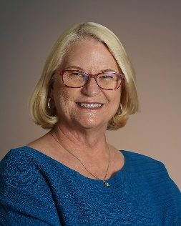
You Have a New Bond Let’s get ready!
CASBO Central Section Fall Conference September 27, 2024
Lettie Boggs, CEO,
leboggs@ColbiTech.com

Slide 3
Have you done this before?
What didn’t work well?
Check your coding, plan with audit in mind
Work on your project list
Initiate budgets
Plan your process

Slide 4
Check your coding
Plan with the audit in mind
Fund – Resource – Year – Goal – Function – Object – School
– XXXX – 0 – 9XXX – 8500 – XXXX – XXX
What money – with who – when – which project – on what – where
Notes:
You should be able to read your coding string like you would read a sentence.

Slide 5
Account Code Strings
The coding structure allows us to call information out in various ways
Facilities needs to understand the code structure in order to make it work for them
Facilities is not in the same business

Slide 6
ORGANIZE THE CODING
The perfect accounting system tracks everything you need to know —
and nothing more!
Fund Codes = The source of the funds
Object Codes = How you spend the money
Unique Project Identifier = Function or Goal (not site!)
Notes:
It is important to concentrate on two components of the SACS code for setting up the building program accounting. School district accounting is designed to do annualized, single fund accounting – and that is not what we are doing in facilities! We typically do multi-fund, multi-year projects. Organizing the accounting will make it easier to accomplish the goals of both.
Everyone needs to know which funds will be used and how much is coming from each contributing fund for each specific project. Not all funding will be available at the beginning, so a comprehensive strategy needs to be in place to move from year to year and to facilitate use of the various funding sources.
When a district accepts state funds for construction or modernization, they accept an additional audit control requirement – project control. The easiest way to facilitate this control requirement is to make sure that the object codes used for the state projects track every component of the state’s audit documentation.
A unique project identifier in the coding string is also required. It should not be the site code as there may be more than one project at a site over time.

Slide 7
Fund – Resource – Year – Goal – Function – Object – School 21 – 96XX – 0 – 9XXX – 8500 – XXXX – XXX
Common Facility Funds by Official Name (CSAM)
01 = General Fund
21 = Building Fund
25 = Capital Facilities Fund
35 = County School Facilities Fund
40 = Special Reserve Funds for Capital Outlay Projects
49 = Capital Projects Fund for Blended Component Units
Sample Local Titles
01 = General Fund
21 = G.O. Bonds
25 = Developer Fees
35 = State School Facilities Program - SFP
40 = Restricted Reserve: Redevelopment, or Restricted Reserve: Capital Development
49 = Mello-Roos Community Facilities District - CFD
For reporting purposes use the local titles that will make sense to people
Notes:
21–50 Capital Projects Funds
21 Building Fund
25 Capital Facilities Fund
30 State School Building Lease-Purchase Fund
35 County School Facilities Fund
40 Special Reserve Fund for Capital Outlay Projects
49 Capital Projects Fund for Blended Component Units
There are more! But these are the primary ones for our projects. Special sources will have other numbers.
When we use titles in public reports that are not representative of the true source of funds, it encourages distrust.

Slide 8
Fund – Resource – Year – Goal – Function – Object – School 21 – 96XX – 0 – 9XXX – 8500 – XXXX – XXX
Resource
Project types are identified by the Resource Code.
For example:
9601 = New Construction (SFP)
9602 = Modernization (SFP)
9603 = Career Tech Ed (SFP)
The District can use part of the code to define types such as:
SFP or not SFP, CTE, DSA Certification, A300, Close Out, etc.
(Maintenance numbers are 91XX)

Slide 9
Fund – Resource – Year – Goal – Function – Object – School 21 – 96XX – 0 – 9XXX – 8500 – XXXX – XXX
Year
Used to clarify grants that span multiple years, not for Facility Projects
Goal This can be used for the project’s unique project identifier – its project number. Any project with state funding is required to have a unique identifier. The project number can be used to sort data by project.
(The unique identifier can alternatively be put in other segments like Management Code or Cost Code)

Slide 10
Fund – Resource – Year – Goal – Function – Object – School 21 – 96XX – 0 – 9XXX – 8500 – XXXX – XXX
Function
The function 8500 means that any expense coded this way will be capitalized. Bond funds can only be spent on capitalized projects, so it will be very rare if your code does not say 8500.
Object
This tells why you spent the money. This is the code that changes based on the type of expenditure. (See Object Code List)

Slide 11
Fund – Resource – Year – Goal – Function – Object – School 21 – 96XX – 0 – 9XXX – 8500 – XXXX – XXX
School or Location
Each school has a unique number.
School numbers are assigned by the state,
use those!
School districts obsess about dividing everything up by site number! This can be problematic for Facilities projects that are district wide or in multiple sites.
There is also typically:
(some differentiate between district wide and multi)
000 = Unassigned
002 = Facilities Branch
222 = Various or Multi Sites

Slide 12
Object codes
Begin with the end in mind
SAB 50-06 Columns
– And they may change!
Have a distinct object code for every reporting category
Make sure your coding matches the way the projects will be billed
You should have a code for every column on the
SAB 50-06 DLOPE
(or any appropriate audit doc)
You can have more – but
you should not have less
If you can’t easily know the number,
it will be a lot of work to track it separately!

Slide 13
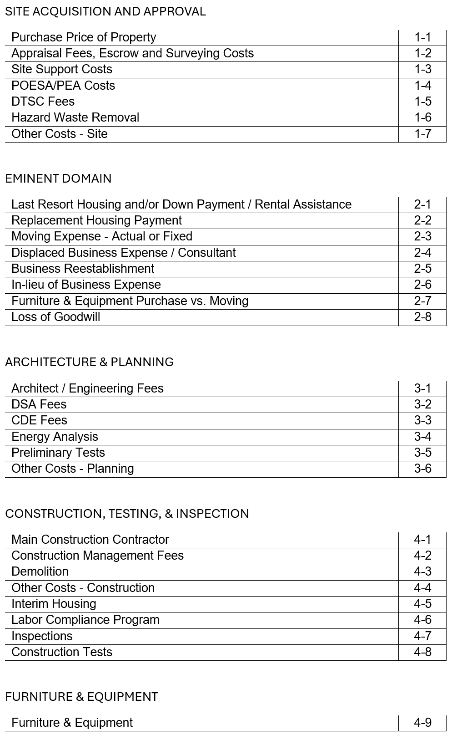
6100’s
Object code list sample
You need an object code for each column – you may want more, but you need at least these
Don’t make Eminent Domain object codes if you are not doing that (Moving Exp not related to EmDom goes in Interim Housing or you can add a code there)
F&E will be 3-5 codes in your Chart of Accounts to facilitate depreciation lists (this is an allowed exception to using only 6XXX objects
6200’s
These numbers indicate the page and column on the DLOPE
4300
4400
& 6400’s
Notes:
Good accounting practice always begins with the end in mind. Understand the reporting requirements so that each project can be tracked in the manner in which it will need to be reported. For Office of Public School Construction projects, the reporting document is the SAB 50-06 Detailed Listing of Expenditures.
Because the Object Code component of SACS tells us what we spent the money on – and the OPSC audit is based on what we spent the money on, it makes sense to align the object codes with the reporting requirements of OPSC. This provides documentation in the fiscal system that will support reconciliation with the audit documentation. Check to see that you have a unique object code for each of the DLOPE columns.
It is also important to structure the coding to minimize the amount of reconfiguring that must be done to incoming invoices when they are being prepared for payment. The more differentiation that is required, the more labor too.
For info on the DLOPE, go to https://www.dgs.ca.gov/ and search for DLOPE. Open the Detailed Listing of Expenditures to get the Instructions which show what will go in each object code. (as of 240925)

Slide 14
Work on your strategies
What projects do you have on your list?
How will you approach them?
Address workload as you craft your list

Slide 15
Tracking A “PROJECT”
Number 1. If OPSC calls it a project — let it stand alone
Number 2. If you bid it together, call that a project
Then how do you track by site?
Differentiated bids matched with back up billing (SOV’s)
Square Footage Allocation
By other agreed basis (cost estimate or other data)
Allocate by transfer at least annually - before EOY
Notes:
The Office of Public School Construction is now requiring a Grant Agreement as a condition for fund release in the School Facilities Program. (For more info on the Agreement go to https://www.dgs.ca.gov/ and search for Grant Agreements. (as of 240925) Funding provided from the SFP can only be spent on allowable expenditures as defined by the Agreement.
Under the new Audit Guidance approved in June 2018, closing was separated from audit and the audit requirements changed. Be sure that each Detailed Listing of Project Expenditures (DLOPE) submitted to OPSC only includes the expenditures allowed by the Agreement. To find out if an item is allowed or not, districts may submit a letter with justification for the expenditure to OPSC for a determination of eligibility called an Advisory Letter. Each letter is only applicable to the item within that project, a separate letter will need to be sent for each item in each project.

Slide 16
Tracking A “PROJECT”
not allowable by the Grant Agreement,
but allowable from other funding sources
You need to have whole project costs in your GL
But you also need to be able to build your SAB50-06 DLOPE to not include expenditures that will not be allowed for state funding
The scope of the audit is what is on the DLOPE, if you are in the regular program
Financial Hardship, CTE, or Charter must include everything

Slide 17
Do not
use state funds derived from interest or savings for items not allowable
Tracking A “PROJECT”
Ideas…
Use the year code to differentiate the items that are legitimate project costs, but will not be reportable to OPSC (for regular program)
Differentiate the project number (A/B) and combine them for full project costs
Do not use state funds derived from interest or savings for items not allowable

Slide 18
Tracking A “PROJECT”
not allowable by the Grant Agreement,
but allowable from other funding sources
GAAP still applies
If they are allowable in your other funding sources,
they are still allowable project expenditures –
you just may not fund them from
Grant + Match + Interest + Applied Savings

Slide 19
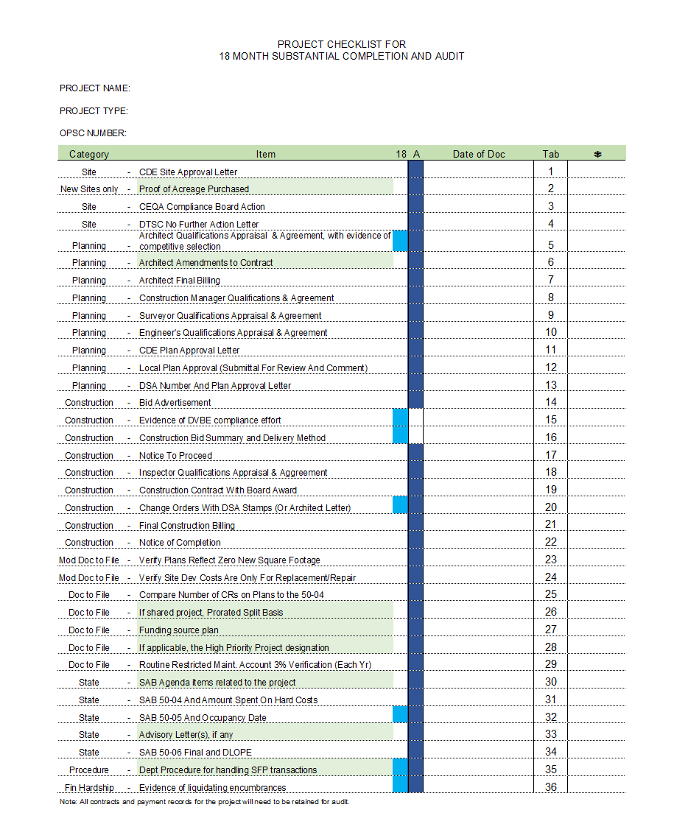
Index of OPSC audit items
Part of tracking a project is keeping track for audit specifically
Green highlights are the new items
Binder or digital – ok
Notes:
This list is for manually keeping the items in a binder.
See link with this PPT to access a free excel spreadsheet and instructions for digital process.

Slide 20
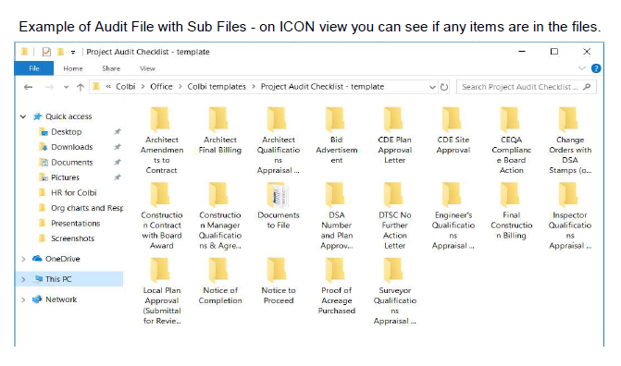
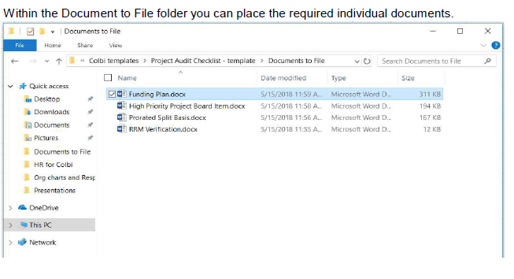
Digital example

Slide 21
Initiate Budgets
Facilities Budgets are different
Multi-Year + Multi-Fund
High Profile + Big $$$

Slide 22
MANAGING BUDGET DEVELOPMENT (Outside the GL)
Initial Planning
Keep refining as land and project size are specified
Design Phase
Refine with each architect estimate
Construction
CM/GC do the construction detail
Monitor Change Order budget impacts
Notes:
Now for the Budget Process…
Initially you know the Project Budget Total Amount. You put 70% in Construction, 20% in Arch/Planning, and hold the remaining 10% as Contingency.
If you initially know the Construction Estimate, put that in Construction. Add to it another 20% for Arch/Planning and 10% Contingency to arrive at the Project Budget. The Construction Budget and the Project Budget are not the same thing!!!
Land always stands on its own as an addition to the above amounts.
As more information becomes available the budget can be made more specific. The more that is known, the more exact the budget can become. As each budget component is completed, transfer any remaining funds on the budget worksheet to another phase or to contingency so that you are working with the maximum funds available as you plan and work the project.
Once an architect is on board and begins to have specific project design information, then architect estimates can be provided. If those estimates are provided in the SAB 506 A&B format, then they will be in the same categories as the district budget and can be used to refine the budget. If the district’s and the architect’s numbers are significantly different, there needs to be a conversation about why. Make sure both documents are including the same items in each category.
Once construction begins, then the schedule of values and other information will be provided by your Construction Manager or General Contractor. The information can be used to keep the budget up to date and to monitor change orders and to pace the use of contingency.
So, the district doesn’t have to fill in all the categories on their own! Other professionals come along side to assist in providing increasingly specific budget numbers. But the district is primarily responsible for the first broad brush budget.

Slide 23
MANAGING BUDGET DEVELOPMENT (Outside the GL)
The danger of layered contingencies
New construction,
10% of the Project budget
Not 10% of the Construction budget!
Modernizations need more, up to 20%
Use of phasing
The less you know,
The bigger contingency you need!
Notes:
Now you have the big picture budget. You can begin to make the case for your bond, or to start site selection. But the budgeting process is not yet complete. As more information becomes available that budget can be made more specific. The more that is known, the more exact the budget can become. As each budget component is completed, transfer any remaining funds on the budget worksheet to another phase or to contingency so that you are working with the maximum funds available as you plan and work the project.
Once an architect is on board and begins to have specific project design information, then architect estimates can be provided. If those estimates are provided in the SAB 506 A&B format, then they will be in the same categories as the district budget and can be used to refine the budget. If the district’s and the architect’s numbers are significantly different, there needs to be a conversation about why. Make sure both documents are including the same items in each category.
Once construction begins, then the schedule of values and other information will be provided by your Construction Manager or General Contractor. The information can be used to keep the budget up to date and to monitor change orders and to pace the use of contingency.
So, the district doesn’t have to fill in all the categories on their own! Other professionals come along side to assist in providing increasingly specific budget numbers. But the district is primarily responsible for the first broad brush budget.

Slide 24
MANAGING BUDGET DEVELOPMENT (Outside the GL)
Monitor the interest
Assign it to projects
The interest is yours, but they track it
Track & report savings
The best strategy is to
keep Fund 35 empty!!!
Notes:
Now you have the big picture budget. You can begin to make the case for your bond, or to start site selection. But the budgeting process is not yet complete. As more information becomes available that budget can be made more specific. The more that is known, the more exact the budget can become. As each budget component is completed, transfer any remaining funds on the budget worksheet to another phase or to contingency so that you are working with the maximum funds available as you plan and work the project.
Once an architect is on board and begins to have specific project design information, then architect estimates can be provided. If those estimates are provided in the SAB 506 A&B format, then they will be in the same categories as the district budget and can be used to refine the budget. If the district’s and the architect’s numbers are significantly different, there needs to be a conversation about why. Make sure both documents are including the same items in each category.
Once construction begins, then the schedule of values and other information will be provided by your Construction Manager or General Contractor. The information can be used to keep the budget up to date and to monitor change orders and to pace the use of contingency.
So, the district doesn’t have to fill in all the categories on their own! Other professionals come along side to assist in providing increasingly specific budget numbers. But the district is primarily responsible for the first broad brush budget.

Slide 25
MANAGING BUDGET DEVELOPMENT (Outside the GL)
The problem with using 5800’s
What type of consultant?
Why are you charging
Operations to Capital projects?
Legal & Advertising are the type of exception the permissive use of Operational Codes for Capital Project was addressing
Notes:
This is the most likely cause of any lack of reconciliation between what Fiscal thinks is happening and what Facilities sees as reality.
Facilities needs to know what type of consultant and it needs to capitalize those expenses, so each type of consultant goes in a specific 6XXX object code.
The 5XXX codes are for Operational Expenses and the money typically available to Facilities Projects cannot be spent on operations so use of 5XXX objects in Capital Funds will likely be a red flag for your auditor.

Slide 26
MANAGING BUDGET DEVELOPMENT (Outside the GL)
What if you do the expenditure budget
and there are not enough funds to cover it?
Do not just fix the budget —
You have to change the project!
Notes:
The human tendency…

Slide 27
MANAGING BUDGET DEVELOPMENT (Outside the GL)
Money
Time
Quality
Notes:
These are connected. If you constrain one, the others increase. If you constrain more than one, something is going to blow out.

Slide 28
PUT THE PROJECTS INTO TIMEFRAMES
DO NOT ORDER BY TYPE OF WORK ONLY!
That causes:
Multiple site disruptions
Unmanageable workload
Max work for Purchasing/Accounting
Poor bid arrangement
And you may
get fired!

Slide 29
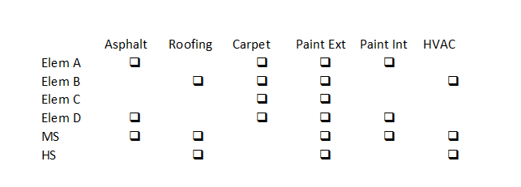
PUT THE PROJECTS INTO TIMEFRAMES
A scatter-gram may help
Do some thinking

Slide 30
PUT THE PROJECTS INTO TIMEFRAMES
Prioritizing Projects- establish criteria
Available matching funding
Benefit the greatest number of students
Visibility
Critical Health and Safety
Parity
Work backwards from the time you need the project.
Summer project, or work during school year?

Slide 31
PUT THE PROJECTS INTO TIMEFRAMES
Get the pointed end in front
You can move a ship through the water sideways, but it takes a lot of force and it is very risky
For better delivery, move it the way it was designed

Slide 32
PUT THE PROJECTS INTO TIMEFRAMES
What order makes sense?
How much work can your team do at once? Pacing
Consider what makes a smart project
How does this affect cash flow?
Do some thinking

Slide 33
Make sure someone is tracking OPSC for any rule or audit changes

Slide 34
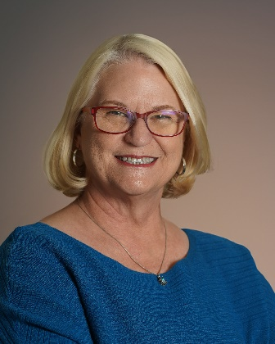
This presentation is available at For more information or for assistance, please feel free to call or email:
https://www.colbitech.com/insight
Lettie Boggs, CEO
714-412-2216
leboggs@colbitech.com
Notes:
Should you need any assistance, or an explanation of these notes, please feel free to call and talk with me about it. We are happy to help!

